Slide 1
Wavecon Telecom Insights from Power BI dashboard
This presentation is a part of data analytics internship by codebasics

Slide 2
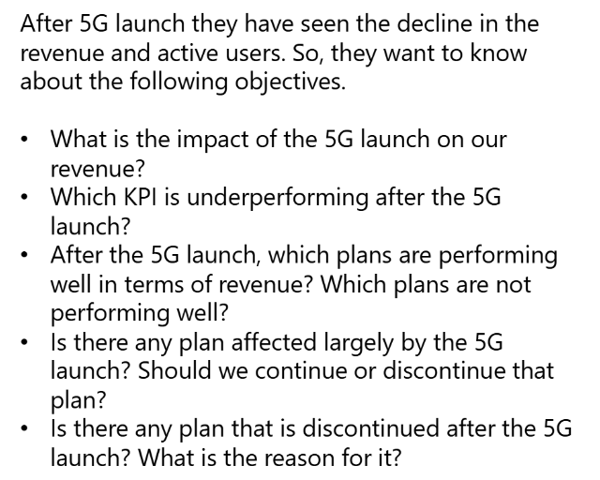
Agenda

Slide 3
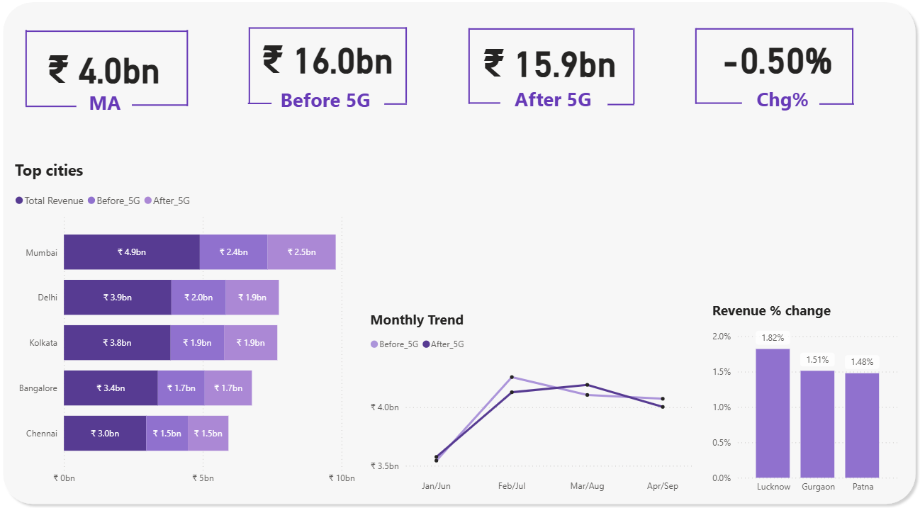
What is the impact of the 5G launch on our revenue?
MA = Monthly Average
Key Highlights:
Mumbai generates the highest revenue
while Raipur generates the least
Revenue dropped by 0.5 %
Lucknow, Gurgaon & Patna show highest percentage change in revenue

Slide 4
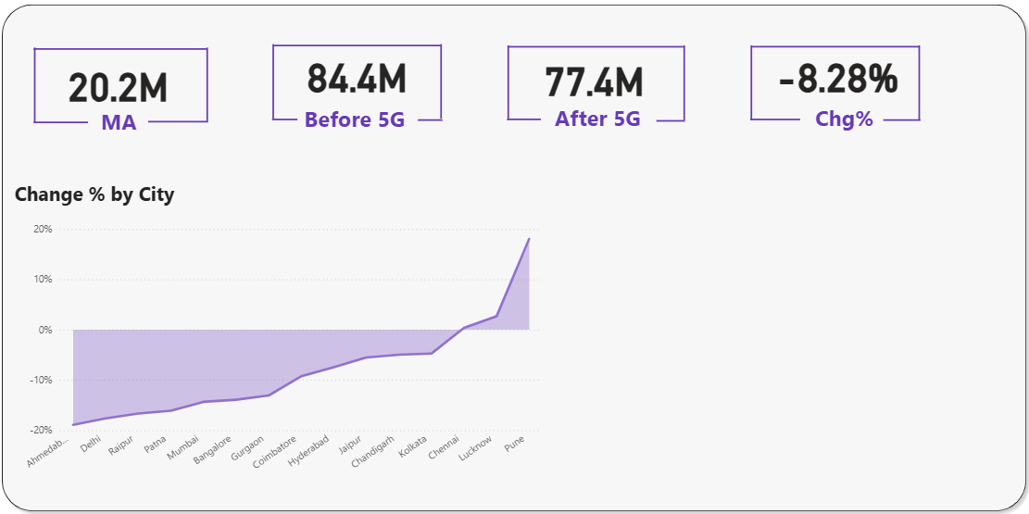
Which KPI is underperforming after the 5G launch?
= TAU Total Active Users
Key Highlights:
Total active users dropped by 7 million
Pune’s 18% increase in active users stands out
Ahmedabad sees a 19% drop in user base
Lucknow and Chennai maintain steady active user base

Slide 5
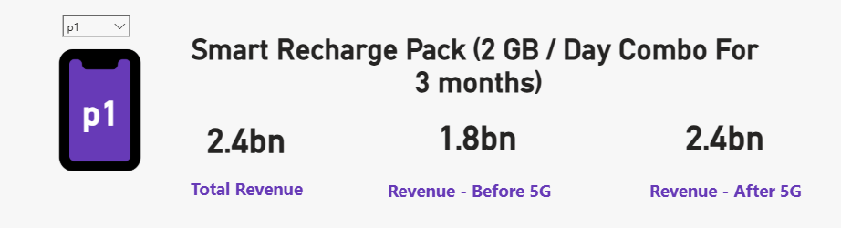
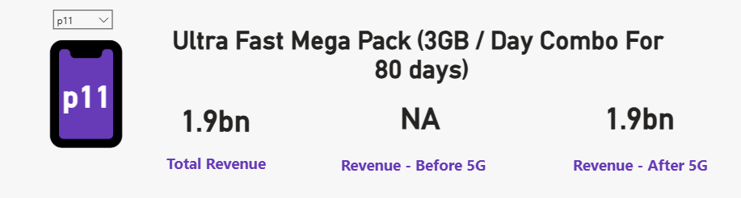
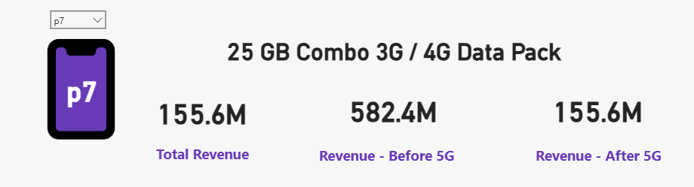
After the 5G launch, which plans are performing well in terms of revenue?
Which plans are not performing well?
Key Highlights:
Plan P1 and P11 show highest revenues
Mumbai is the top performer
Plan P7 shows the lowest revenue generated
Bangalore is the top performer

Slide 6
Is there any plan affected largely by the 5G launch?
Should we continue or discontinue that plan?
Key Highlights:
P1 plan : revenue increased by 600M
P7 plan : faced a significant revenue drop of 427M after 5G launch, suggesting it should be discontinued

Slide 7
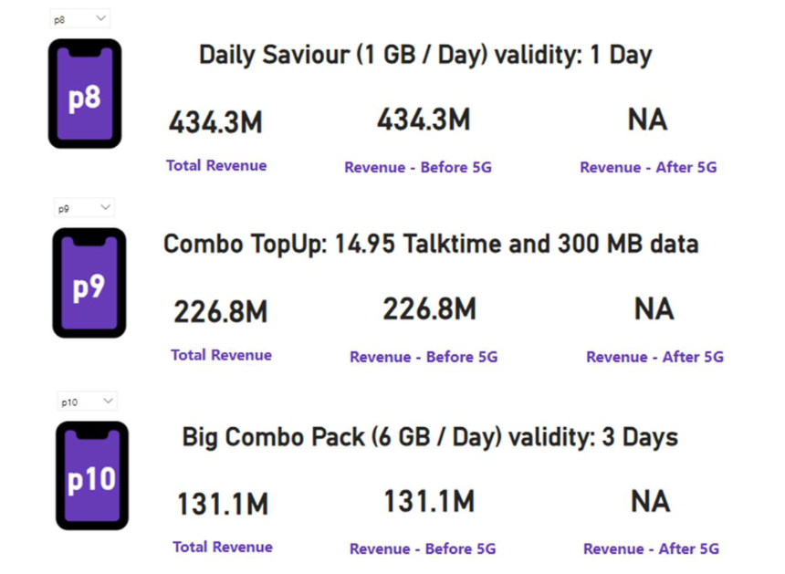
Is there any plan that is discontinued after the 5G launch?
What is the reason for it?
Key Highlights:
P8 plan : Discontinued due to short validity and inadequate data after 5G launch
P9 plan: Discontinued due to inadequate data and unlimited talk time after 5G launch
P10 plan: Discontinued due to its short 3-day validity

Slide 8
Report by Parth S Data Analyst Intern AtliQ Technologies

